Slide 1
Metaphysical Poetry and
Cavalier Poetry

Slide 2
For a period after the Renaissance, poetry was divided into 2 trends: the Cavalier poets and the Metaphysical poets.
The Cavalier Poets defended the monarchy against the Puritans during the reign of Charles I :
Robert Herrick, Thomas Carew, Robert Lovelace, Sir John Suckling
ideal gentleman - a lover, a soldier, a wit, a musician, a poet
light-hearted approach to life
poetry for births, marriages, and great parties
poems embodied the spirit of the upper classes before the Puritan Commonwealth

Slide 3
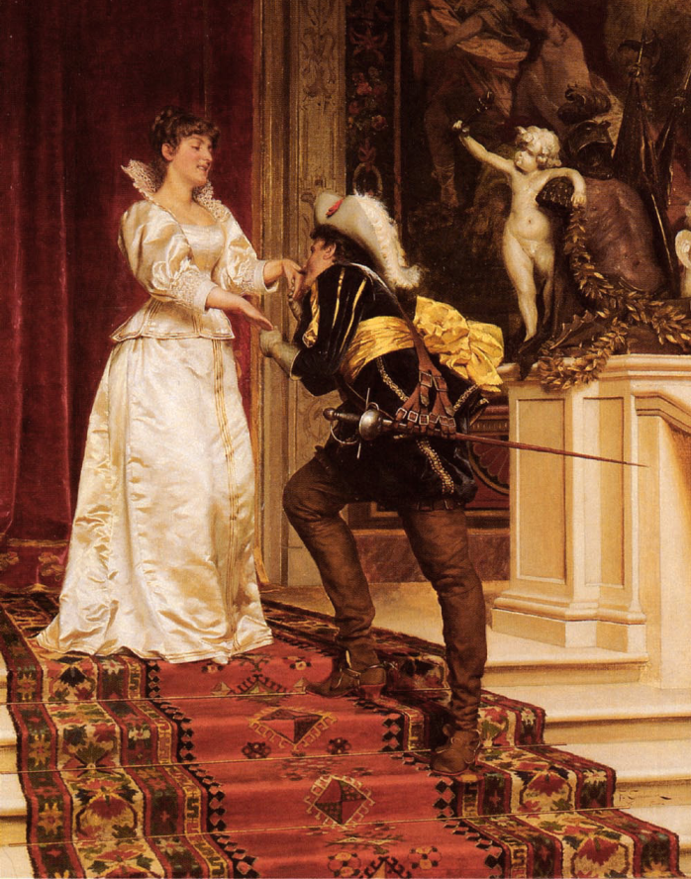
To Electra
I dare not ask a kiss;
I dare not beg a smile;
Lest having that or this,
I might grow proud the while.
No, no, the utmost share
Of my desire shall be
Only to kiss the air
That lately kissed thee.
Robert Herrick

Slide 4
Metaphysical poetry, led by Donne
Metaphysical = after or beyond the physical
Deals with questions that can not be explained by science
Highly intellectualized
Strange imagery or conceits
Frequent paradox
Extremely complicated thoughts
George Herbert
Richard Crashaw
Henry Vaughan
followed in the tradition of John Donne (1572-1631);
misleading term “metaphysical “ used by literary critic Samuel Johnson, the 18th century;
the poetry did not deal with philosophical speculation but with the themes of religion and love;

Slide 5
The features of Metaphysical poetry
the use of conceits: comparisons between objects which at first glance seem to have nothing in common;
the argumentative quality of the love poems, in which the poet tries to persuade his lover to share his point of view;
the dramatic quality of the language, which often seems to be one side of a dialogue between the poet and his lover, or God, or himself;
the wide range of subjects from which the poet draws his imagery (sciences, travel, medicine, alchemy, philosophy) – vs. Elizabethan poetry (which used the stock imagery of the period - birds, flowers, sun, moon, stars);
the use of wit (in the 17th century - the ability to relate dissimilar ideas, implied intellectual genius - use of paradoxes, conceits, puns)

Slide 6
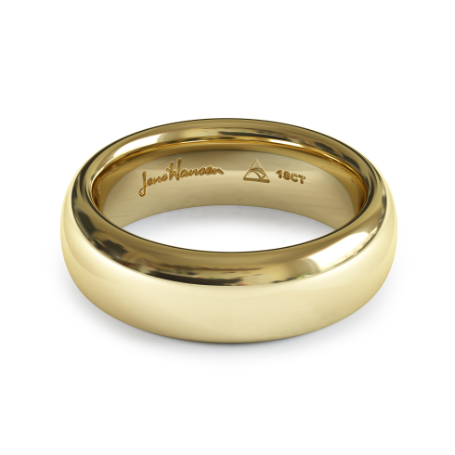
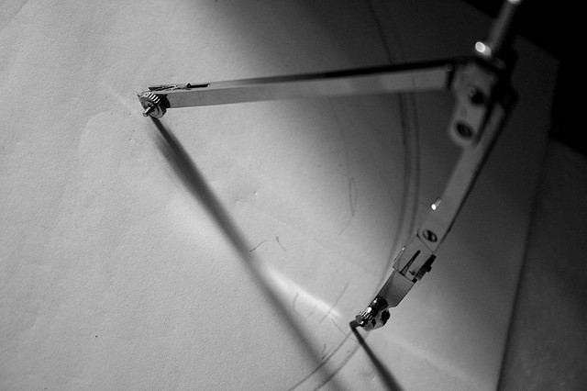
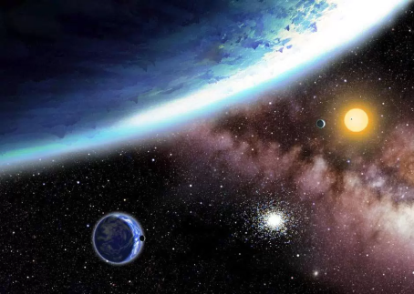
Imagery / References to Donne's learning
The circle
Marriage ring
Path of the planets (Trepidation of the spheres)
Alchemical symbol for gold was a circle with a point in the centre
Path described by a compass.
Very broad range of knowledge displayed:
planetary trepidation
earthquakes, the love of "sublunary lovers"
properties of gold – malleable, the most precious of all the metals, the least reactive of all metals, the most noble metal, the most difficult to destroy
compass imagery and use

Slide 7
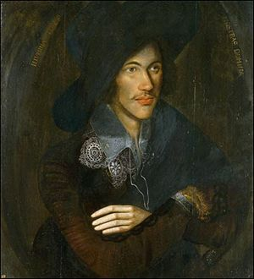
John Donne (1572-1631)
born in London to a prominent Roman Catholic family;
converted to Anglicanism during the 1590s;
at the age of 11 entered the University of Oxford, then Cambridge – took no degree;
1592 - began the study of law at Lincoln's Inn, London; legal or diplomatic career;
1598 - appointed private secretary to Sir Thomas Egerton, Keeper of the Great Seal;

Slide 8
John Donne (1572-1631)
1601 - secretly married Egerton's niece, Anne More;
dismissed from his position, brief imprisonment;
made a meagre living as a lawyer;
Divine Poems (1607);
1615 - became a priest of the Anglican Church, appointed royal chaplain;
1621 - named dean of St. Paul's Cathedral;
attained eminence as a preacher, delivered the most brilliant and eloquent sermons of his time.

Slide 9
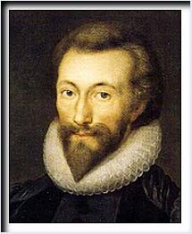
John Donne (1572-1631)
a wide range of secular and religious
subjects:
cynical verse about inconstancy,
poems about true love,
Neoplatonic lyrics on the mystical union of lovers' souls and bodies,
brilliant satires and hymns depicting his own spiritual struggles

Slide 10
John Donne (1572-1631)
Characteristics of Donne’s poetry
(typified the work of the metaphysical
poets):
dazzling wordplay, often explicitly sexual;
paradox;
subtle argumentation;
surprising contrasts;
intricate psychological analysis;
striking imagery selected from nontraditional areas (law, physiology, scholastic philosophy, mathematics)

Slide 11
John Donne (1572-1631)
Prose: The Sermons (160)
imaginative explications of biblical passages;
intense explorations of the themes of divine love and of the decay and resurrection of the body;
Devotions Upon Emergent Occasions (1624)

Slide 12
Some works by John Donne
Poetry
Satires (1593)
Songs and Sonnets (1601)
Divine Poems (1607)
An Anatomy of the World (1611)
The Second Anniversary. Of The Progress of the Soul (1611)
An Anatomy of the World (1612)
Devotions Upon Emergent Occasions (1624)
Wisdom crying out to Sinners (1639)
Essays
Three Sermons Upon Special Occasions (1623)
The First Sermon Preached To King Charles (1625)
Essays in Divinity (1651)

